Slide 1
Lesson 2 : Debugging

Slide 2
Practice Trace Table -Python Programming
Given Link for the presentation : https://docs.google.com/document/d/1RHVRhW70WlF5by3igX5ytok8VKeFDiu78yy2Nl1GXUc/edit?usp=sharing

Slide 3
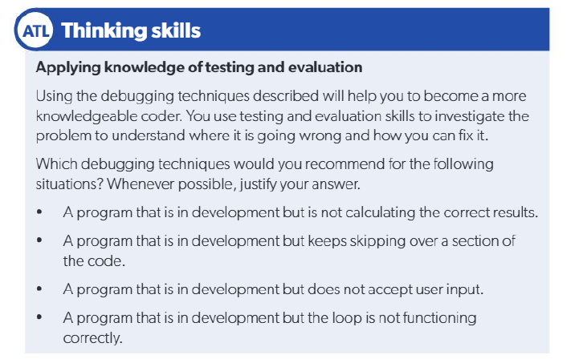
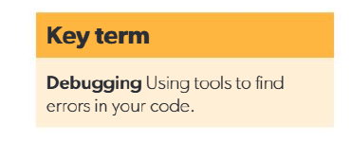

Slide 4
